Slide 1
GA PROFILES
& PORTFOLIOS
Notes:
What are Profiles? 20 mins (9:05-9:25)
Profiles Demo 5 mins (9:25-9:30)
Expectations: 5 mins (9:30-9:35)
Work on your Profile: 40+ mins (9:35-10:15)
Outcomes Assignment: 5 mins (10:15-10:20)
Final Outcomes Workshops: 5 mins (10:20-10:25)
End at 10:25

Slide 2
QUALIFIED JOB SEEKER CHECKLIST
LinkedIn
Personal Brand Statement
Resume & Cover Letter
Job Tracker
Portfolio or Static Project Website
GA Profile
Reminder: You must have these materials reviewed and approved by Outcomes team within 1 week of graduation in order to get job seeker qualified (ie - getting referrals and post-course outcomes support).

Slide 3

YOUR ENTIRE PACKAGE
Think of how employers will find you:
GA Profile
Portfolio
Blog
Linkedin profile
Online engagement
Meetups and in-person networking

Slide 4
GA PROFILES
HOMEWORK

Slide 5
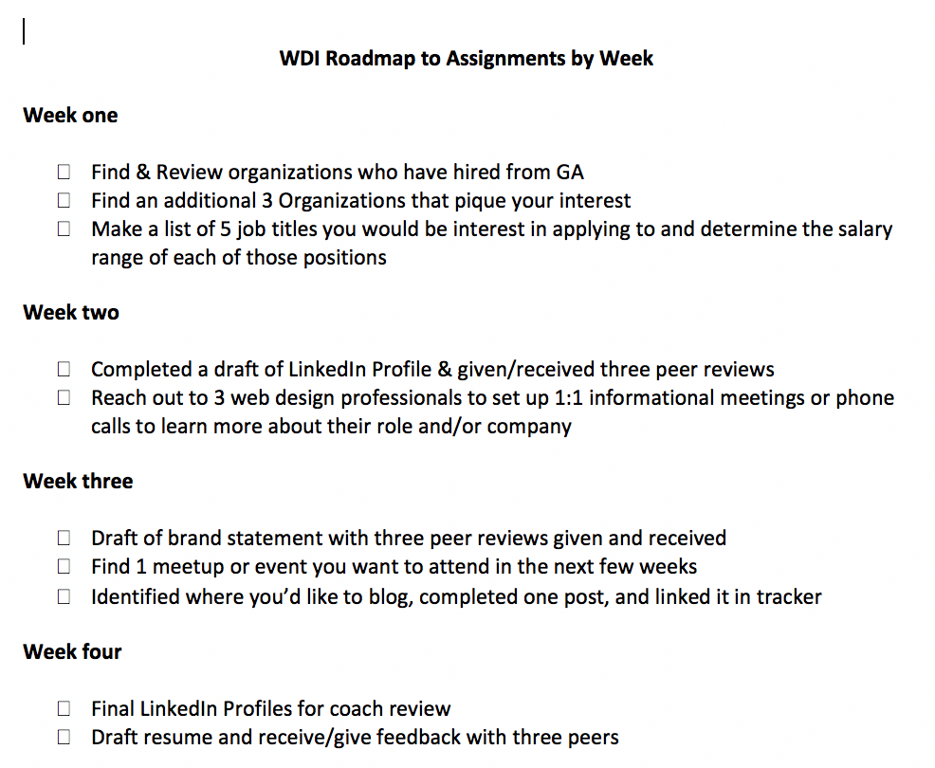
SHOULD BE DONE BY NOW

Slide 6
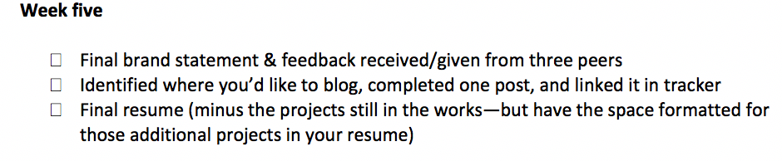
THIS WEEK’S HOMEWORK

Slide 7
GA PROFILES
GA PROFILES

Slide 8
GA PROFILES
WHY DO I NEED A GA PROFILE?
“I already have a LinkedIn, a resume, a portfolio, and a pretty face?”
You, Probably

Slide 9
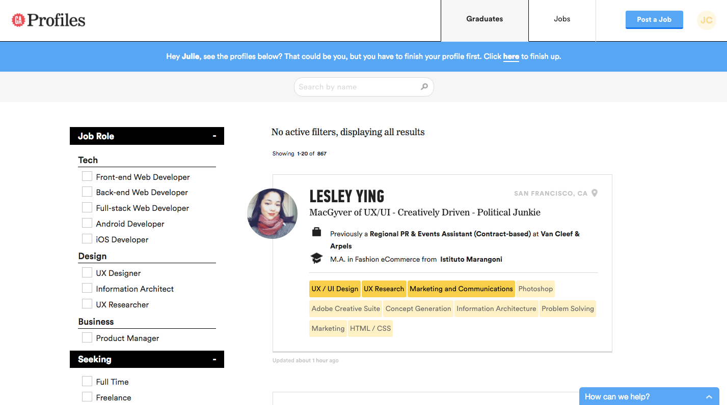
GA PROFILES
WHAT IS PROFILES?
Employer view:

Slide 10
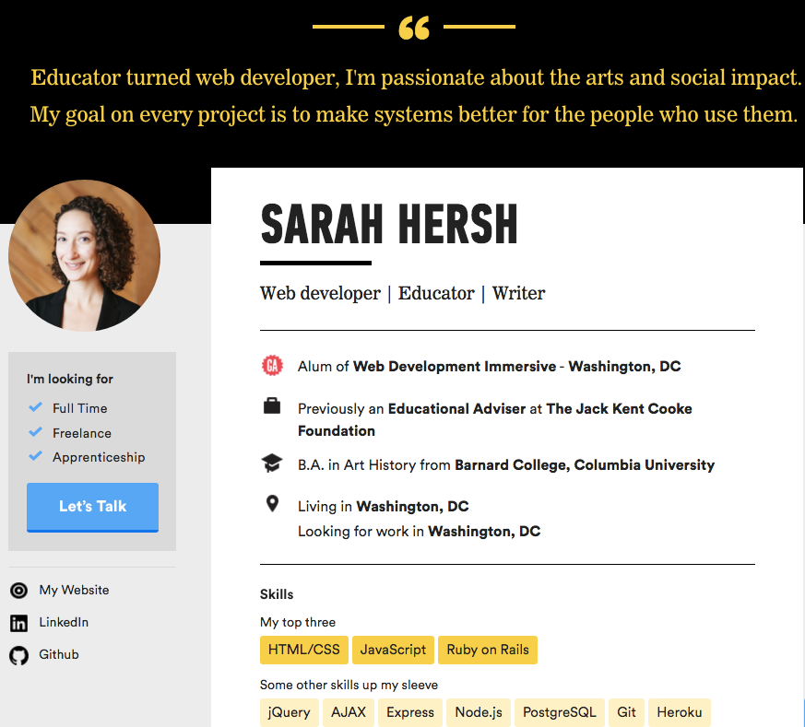
GA PROFILES
WHAT ARE PROFILES?
Main profile view
See more at http://profiles.ga.co

Slide 11
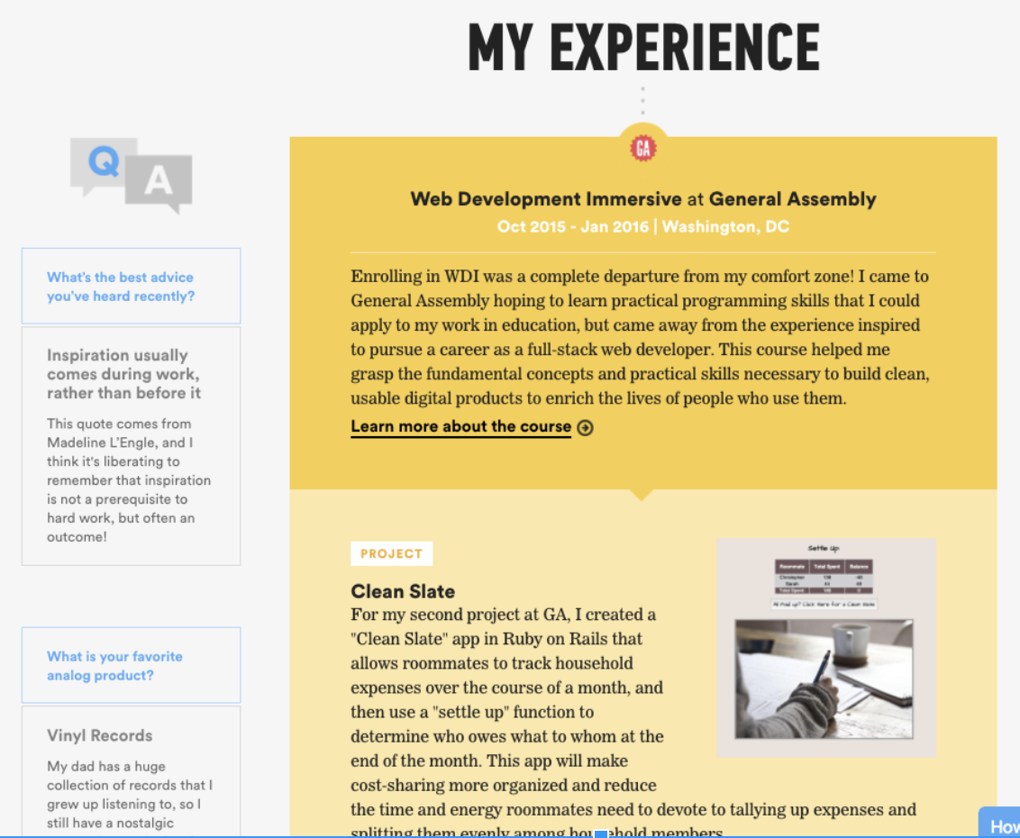
GA PROFILES
Profile continued:

Slide 12
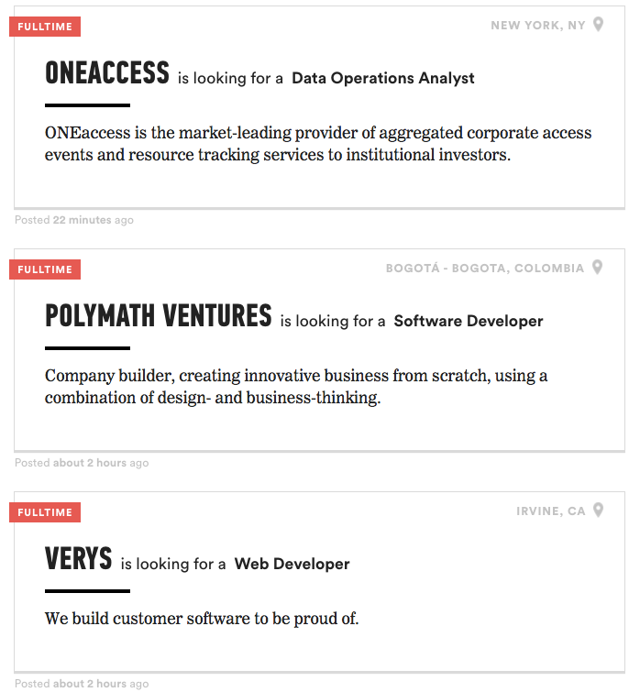
GA PROFILES
WHAT IS PROFILES?
Job board for GA alumni:

Slide 13
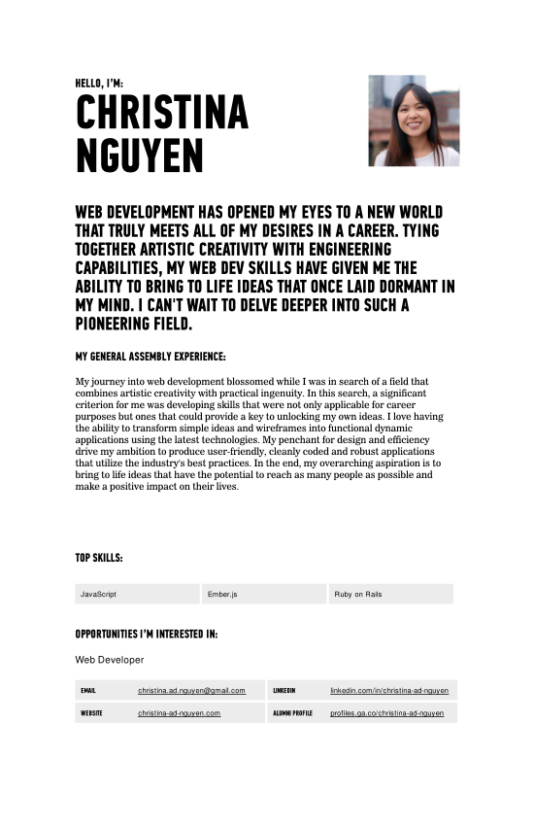
GA PROFILES
TALENT SHOWCASE BOOKLET PAGE
About Me: Summary
Celena’s page
Education: GA Course details
Skills: Primary skills
The Basics: Web presence

Slide 14
EXPECTATIONS
EXPECTATIONS FOR GRADS
It is your responsibility to ensure content is accurate and updated.
Grads must respond to employer outreach within 24 - 48 hours whether you want the job opportunity or not.

Slide 15
GA PROFILES
CREATING YOUR PROFILE

Slide 16
CREATING A PROFILE
DO THIS FIRST! Make a copy of the Profile Template.
DO THIS NEXT: Fill out the Profile Template (all sections must be complete for me to review) and share the link via the toolkit box.

Slide 17
CREATING A PROFILE
ONCE CONTENT IS APPROVED
DO THIS: you must login at www.generalassemb.ly
THEN, in a NEW window or tab go to:
profiles.ga.co/profiles/new

Slide 18
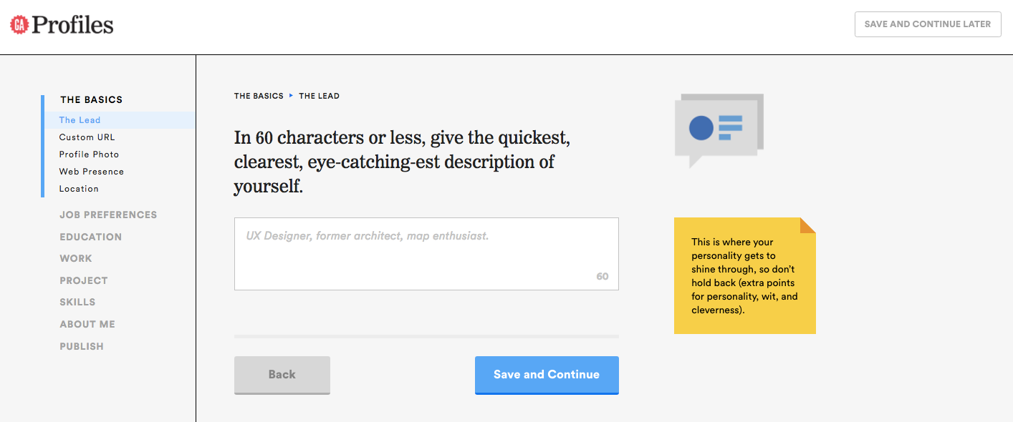
CREATING A PROFILE
BOOKMARK THIS PAGE: profiles.generalassemb.ly
“Save and continue” functionality → Use both buttons
Don’t use the nav bar – use the save buttons as if you use the bar it won’t save your progress if you don’t save and continue each time
Can’t log in? Try logging out and in again. Still can't? Try visiting http://ga.co/newprofile.

Slide 19
GA PROFILES
THE JOB BOARD

Slide 20
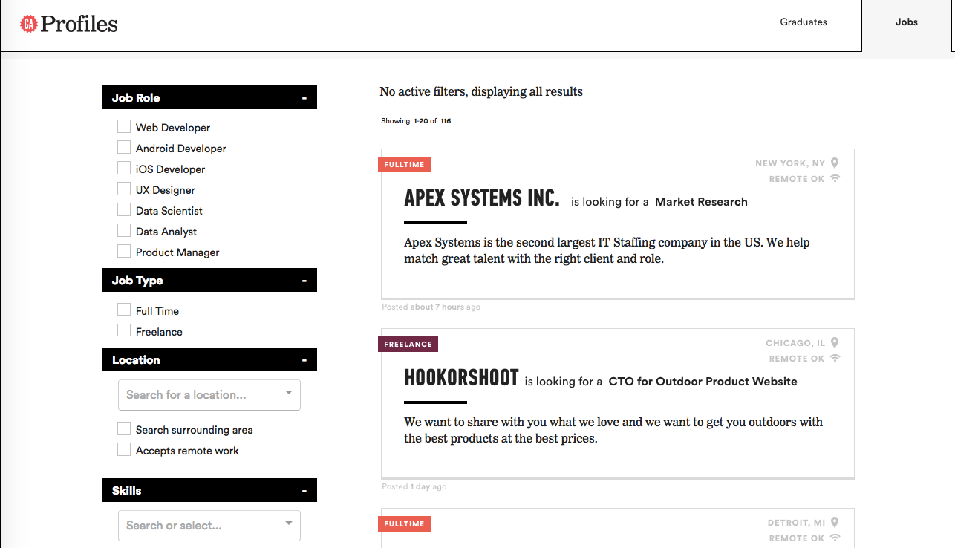
THE JOB BOARD
Immersive Alumni will have access to apply for jobs once their profile is published.

Slide 21
THE JOB BOARD
Employers post their job openings for full time and freelance projects.
Employers choose one of two options for grads to apply:
Via their own website
Via email
Employers will start using Profiles in multiple ways:
Viewing students who have skills and/or backgrounds that may be a fit for their company.
Sharing student information with coworkers.
Contacting students asynchronously or across metro areas.

Slide 22
THE JOB BOARD
Expectations of students using Profiles:
When you get a job opportunity, you reply within 24 - 48 hours whether you want the job opportunity or not as this shows consideration and respect to employment partners.
Keep your Profile fresh and current.
Make sure your location for employment are up-to-date

Slide 23
DENVER OUTCOMES - WDI
PORTFOLIOS & BRANDING

Slide 24

WHAT WE’LL COVER TODAY
Goals of a portfolio
Knowing your audience
Class review of sample portfolios
Portfolio in-class workshop
Looking ahead
Creating GA Profiles https://profiles.generalassemb.ly/profiles/new
Linkedin

Slide 25

OBJECTIVES
Portfolios are a great way to showcase your skills, projects and Job Search Toolkit all on one platform.
Similar to your materials, your portfolio should help tell your story and showcase your brand to both technical and non technical audiences.
You don’t need to complicate it and can use a template.

Slide 26
YOUR IMAGE
Your Brand Statement
Portfolio
GA Profile
Linkedin Summary
Resume
Cover Letters
How You Present Yourself
Practicing Your Pitch

Slide 27
GOAL OF YOUR PORTFOLIO
Show off the projects you’ve built
Showcase personal brand and unique attributes
A wide demonstration of skills
Projects presented are quality over quantity
Demonstrates technical skill
Depth of process communicated effectively
Shows impact of work and validation
Your role is clear vs. others’ roles in projects

Slide 28
CONTENT, TIPS, AND TRICKS
Even if you are not a designer, you still want to have an aesthetically pleasing portfolio.
WHAT SHOULD YOU ADD?
STRATEGIES FOR A BETTER PORTFOLIO
Projects
Visualizations
A bio or about page (tell your story!)
Blog
Relevant skills
Relevant education and certificates
Any previous jobs that have some transferable experience
Downloadable resume
A photo
Review other Dev portfolios
Do not copy, but allow them to inspire you
Make it YOUR portfolio
Ask a designer for feedback
Review it like a hiring manager

Slide 29

WDI PORTFOLIOS : YOUR AUDIENCE
Portfolios should communicate:
Who you are and what you do
What you have worked on
How to contact you
Target your audience:
Future Employers (Hiring Managers/Recruiters/Data Scientists)
Potential new contacts/peers/mentors

Slide 30
LEARNING OBJECTIVES
ONLINE PORTFOLIOS
Use industry portfolio trends and examples to inform their own portfolio design
Align their portfolio/project with their professional goals
Understand the heightened role that portfolio/projects play in the job search process

Slide 31
ONLINE PORTFOLIOS
WHY DO I NEED A PORTFOLIO?!

Slide 32
ONLINE PORTFOLIOS
Why:
So your personality & brand can shine through.
So you can establish your credibility.
So people (hiring managers) to easily find you online.
People literally won’t hire you without one
Creating your portfolio is a project in itself!
Set dedicated time aside to work and refine your portfolio!
Ask for feedback from multiple people!

Slide 33
ONLINE PORTFOLIOS
PORTFOLIO ESSENTIALS

Slide 34
PORTFOLIO ESSENTIALS
Who is your audience?
What are you trying to communicate?
Do you have all your content (pictures + text) together?
What are your competitors doing?

Slide 35
PORTFOLIO ESSENTIALS
Identify your audience:
Recruiter
Head of Engineering/Manager
Startup
Agency
Enterprise/Consultancy
Identify your objective:
Full time work
Part time work
Freelance
Contract
Begin your own startup

Slide 36
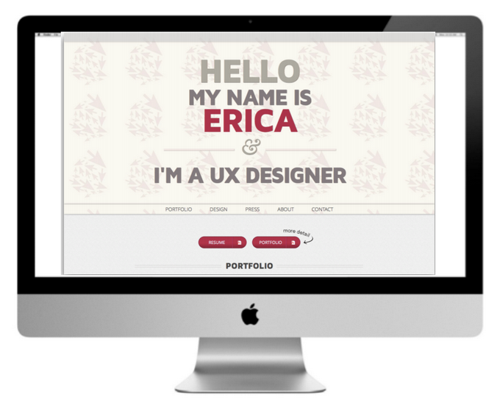

PORTFOLIO ESSENTIALS
Purpose:
Who are you?
What do you do?
What have you done?
What can you do?
What are you capable of?

Slide 37
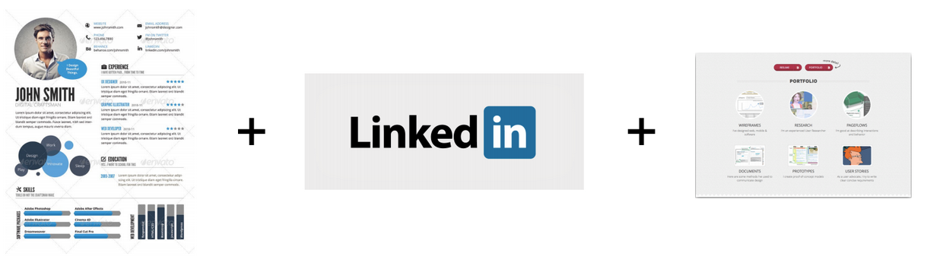
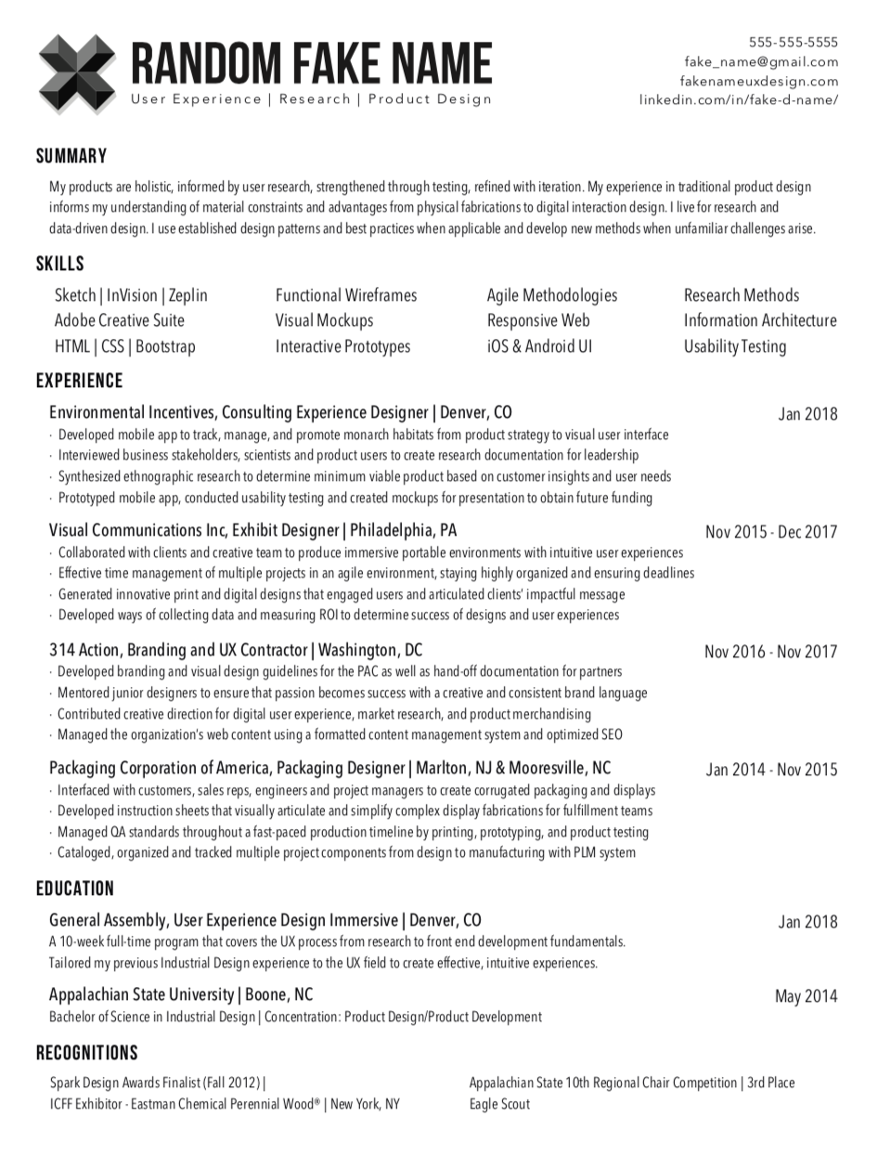
PORTFOLIO ESSENTIALS
A portfolio website is an extension of your resume and LinkedIn.
They should all reinforce each other.

Slide 38
ONLINE PORTFOLIOS
WHAT TO INCLUDE

Slide 39
WHAT TO INCLUDE
Most portfolios today are only one page, and consist of several sections:
Intro - A short blurb explaining what you do
Work - Thumbnail links to all your projects (these can open in a lightbox, or in a separate page)
About - Tell them a little about you, and link to your resume
Contact - List your email or have a contact form, with links to RELEVANT social media

Slide 40
WHAT TO INCLUDE
Good Examples:
Grads:
Clay Smith (WDI2)
Jacy Anderson (WDI3)
Taylor Laine (WDI3)
Court Fay (WDI5)
Emma Demango (WDI5)
You can have a cool minimalist portfolio once you have experience For now, maximum effort is required.
Pros:
Nick Anderson
Matt Webb
Drew Dahlman
Rafael Caferati
Josue Espinosa
Notes:
Go through these and talk about them

Slide 41
WHAT TO INCLUDE
Projects
LINK to your live project
Image of the finished project
A (short) story about your work. For EACH project talk about:
What was the project for?
What tools did you use to build it?
What was your role in the team?
How long did you work on it?
What did you contribute (be specific)?
Where is it now?

Slide 42
WHAT TO INCLUDE
Things to keep in mind:
Approach it from a user-centered perspective (your user is the viewer / hiring manager / client).
Create a visual narrative of your process and projects INCLUDING the messy stuff (good design is messy).
Frame your projects and create the context, don’t be repetitious.

Slide 43
ONLINE PORTFOLIOS
TIPS FOR A GREAT PORTFOLIO

Slide 44
TIPS
Choose a few projects so you can showcase the breadth of your work and your skills.
Keep the website design simple.
Let the content you made take center stage rather than the design of the website.
Make the content easy to access.
Keep the navigation simple.
Be unique.
Personalize your “about” page to tell your story, not just list your past jobs.
Share a point of view.
Tell your story.

Slide 45
TIPS
Be Human.
Have any hobbies or interests you obsess about?
Reveal some guilty pleasures keeps your bio approachable and relatable.
Invite people to contact you – be inviting and welcoming.

Slide 46
ONLINE PORTFOLIOS
HOW?

Slide 47
HOW
You must code your own.
This means you need a domain name and hosting.

Slide 48
ONLINE PORTFOLIOS
HOSTING?

Slide 49
HOSTING?
Hosting is like renting an apartment for your website to live in - and just like apartments, price, quality, and perks can vary. Most of them will offer to sell you a domain name with their services. Here’s some services you might want to check out . . .

Slide 50



HOSTING?
Github You already know how to use it, and it's free! You'll have to jump through some hoops to set up it, though - documentation can be found here. If it were an apartment: Sleeping on your friend’s couch
Dreamhost Standard fair hosting service. around $25/mo. Handles domain, email, and other common services for you. Almost unlimited storage. See also: Bluehost. If it were an apartment: A studio apartment with a reliable handyman

Slide 51

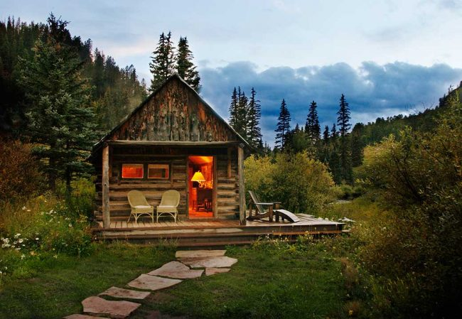
HOSTING?
Amazon Web Services Cheap and scalable - only pay for what you use (could be as low as $1-3/mo). No frills. If it were an apartment: A converted factory space with a water/gas hookup but no appliances. Or walls. Great if you like DIY projects!
Heroku Cloud app hosting - Probably overkill for what you need, but good if you want to scale to hosting full apps. Price tiers based on usage, from free to $500/mo. If it were an apartment: A cabin on 40 acres of land in the woods. You only pay for the space you actually use.

Slide 52
ONLINE PORTFOLIOS
DOMAIN NAME?

Slide 53
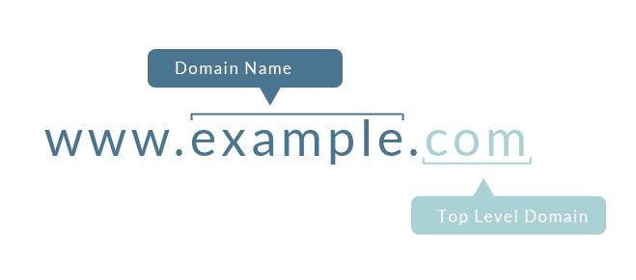
DOMAIN NAME?
A domain name is the address you type in to visit your website. It consists of two parts - the domain name itself, and the top level domain:

Slide 54
DOMAIN NAME?
For your Domain Name, you’ll want to make this something simple - as close to your name as possible is always a good bet. Avoid picking domains with numbers, dashes, or special characters in them, or with specific job titles in it (i.e. NickAndersonUX.com). As the industry changes, these buzzwords tend to age poorly.
For your Top Level Domain, you have over one thousand options to choose from. A few good choices are:
.com - standard
.co - also good, common for portfolio sites
new top level domains - great if relevant (i.e. .design or .work), or show personality (ie. NickAnderson.Rocks)
AVOID .net and .biz. These have become associated with businesses that were late to the dotcom boom, and still give some employers the impression of unprofessionality.

Slide 55
DOMAIN NAME?
You can expect to pay between $10-30/year for domain name. You can buy it at any time, but keep in mind that many hosting services will bundle it with your hosting package to make it cheaper and easier to set up. If you do purchase the domain name separately, be sure to do so through a reputable service, such as:
Google
NameCheap
HostGator
GoDaddy

Slide 56
ONLINE PORTFOLIOS
K NOW WHAT

Slide 57
K NOW WHAT
Make a website! I suggest using a bootstrap template. Many are free:
Start Bootstrap
Shape Bootstrap
Wrap Bootstrap(not free)
Want to make one from scratch? Make one from a template first, and get it up so you can start finding a job. You can launch version 2.0 after grad when you have more time.

Slide 58
K NOW WHAT
Then push it up!
Your hosting company should provide you with a list of ways to deploy your site to the live hosting environment. A common method is FTP, in which you upload your files through an FTP client like FileZilla or CyberDuck. The obvious downside of this is that there is no built-in version control - this is why you'll want to work on a github repo regardless of how static your site is, then dump your files on the FTP server after you commit/push.
Another option is some kind of middleware that deploys from your repo for you. DeployBot, for example, hooks into both your Github and Hosting account, and pushes from Githubt to your host when you tell it to.

Slide 59
K NOW WHAT
Common Issues and Testing
There's a few things to keep in mind as you progress through this process:
It will take a while for your hosting/DNS to propagate - sometimes up to 48 hours. Do not be alarmed if you cannot reach your website (either through your browser or FTP) for a couple days after purchasing it.
Furthermore, changes made to your hosting environment will sometimes take a few minutes to take effect. Be sure to check caching settings in your hosting service - if your site is being cached, you will not see changes until you hard-refresh or delete your cookies.
Don't delete anything in your hosting directory just cause you don't know what it is. Read your hosting documentation and see what it says about any mysterious files or directories you encounter.
Don't change settings you don't understand in your hosting account. These will vary by hosting type, but in general, if you don't know what it is, don't change it.

Slide 60
K NOW WHAT
I’m not going to remember this
Then fork and clone this repo: https://github.com/den-materials/portfolio-starter-kit

Slide 61
ONLINE PORTFOLIOS
EVEN MORE EXAMPLES

Slide 62
WDI PORTFOLIOS: EXAMPLES
http://marissafullford.co/
https://qoneill.herokuapp.com/
http://www.emmademango.co/
http://www.courtneyfay.com/
http://miketheocodes.com/
http://www.coreyselover.com/
Even more GA Example Portfolios:
http://tylerclark.codes
http://patrickbotkins.com/
http://www.lauranemazee.com/
http://www.aaronmiddleton.co/
http://joshuaryanhugh.es/
http://www.emmademango.co/
http://markrosenberg.co
http://jacyanderson.co/

Slide 63
HELPFUL ARTICLES
BUILDING A WEB DEVELOPMENT PORTFOLIO
https://skillcrush.com/2015/03/12/impressive-tech-portfolio/
https://www.shopify.com/partners/blog/web-developer-portfolio
https://toggl.com/blog/web-developer-portfolio/
https://www.sitepoint.com/how-to-create-a-portfolio-site-that-will-get-you-hired/
https://medium.freecodecamp.org/15-web-developer-portfolios-to-inspire-you-137fb1743cae

Slide 64
ATLANTA OUTCOMES - WDI PORTFOLIOS
YOUR THOUGHTS

Slide 65
WDI PORTFOLIOS : GETTING STARTED
Below are a few options that we recommend you consider when creating your portfolio. You can choose your preference but encourage you to think about what is the easiest way to create and maintain it given all of your current responsibilities in class. They are Code from scratch
Carrd: Custom Domain, Easy to set up and navigate, $19/year
https://pages.github.com/
Check out these top portfolio wordpress themes
Deploying Bootstrap: Custom Domain, Customizable, Code from scratch, Free
Check out these bootstrap portfolio themes
Portfolio Box: Custom Domain, easy to use, free version or pay $6.90/month for customized domain
Crevado
Bit Balloon: Customize Domain, controlled with API, $5/month for your own domain

Slide 66
PORTFOLIO RESOURCES
35 (More!) of the Best Personal Websites We've Ever Seen
The Muse: 4 Secrets to Building a Portfolio That’ll Make Everyone Want to Hire You
27 Things to Put in Your Portfolio When First Starting Out
24 Great Personal Websites

Slide 67
DIGITAL PRESENCE AND TOOLS
BLOGGING
Notes:
Go back to drawing…

Slide 68
Why is blogging important?
BLOGGING
As we talked about in the LinkedIn presentation, a blog”
Gives you something to “offer” the world as you networking
As a contributor to the field, it gives you a conversation starting point and encourages others to engage in a dialogue with you
It offers another way to network by having people “follow” your blog.
If others enjoy the content, they may link it to their network, which will expand your brand and place in the web development community.

Slide 69
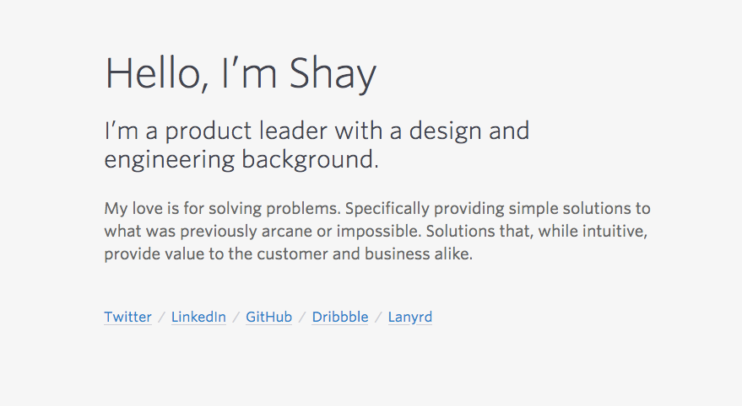
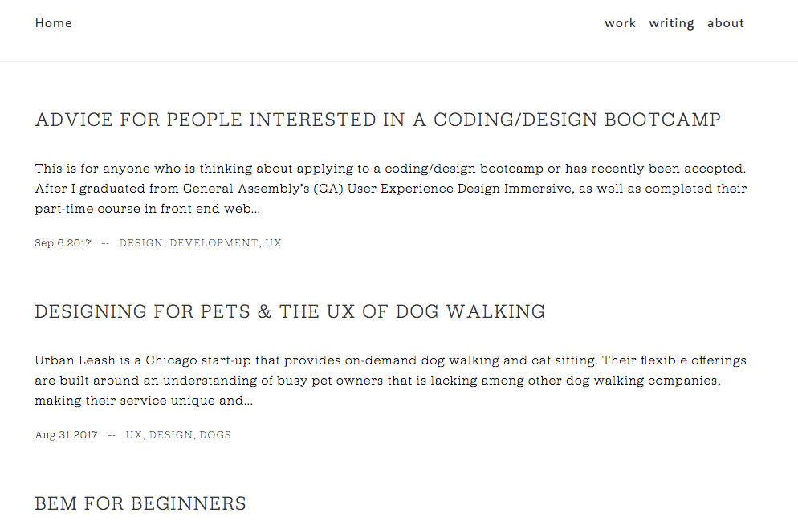
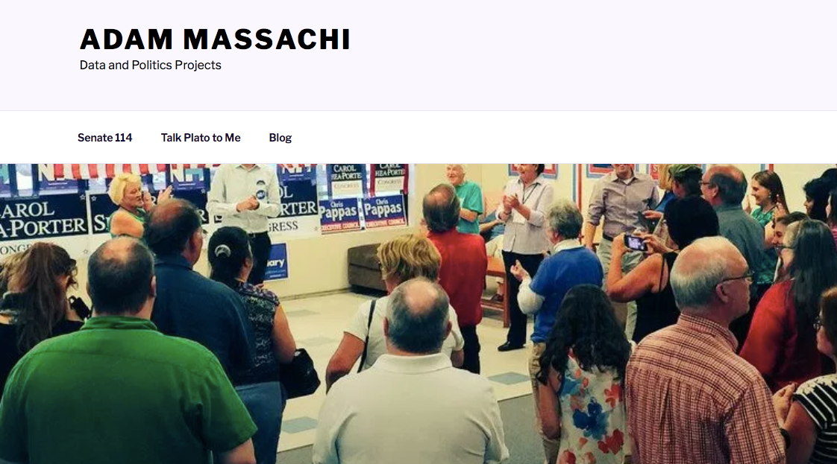
BLOGGING

Slide 70




Blogging Sites
YOUR OWN PERSONAL SITE?

Slide 71
HOMEWORK
HOMEWORK

Slide 72
THIS WEEK’S HOMEWORK

